Slide 1
Career Ready 101
Directions on How to Select Lessons

Slide 2
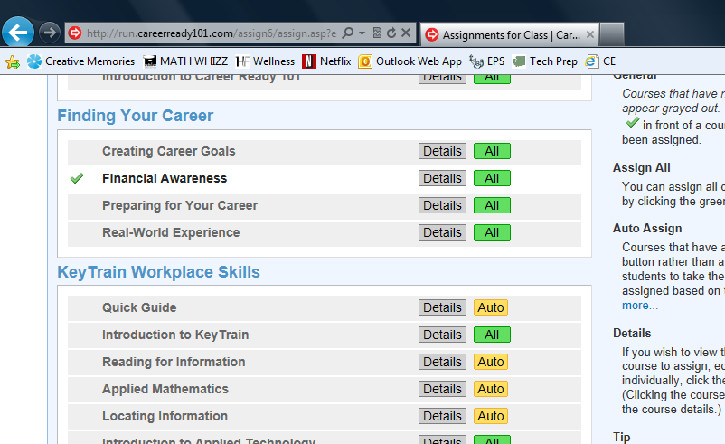
Decide on Lessons to Assign
Lessons shown here are to help prepare students for the NCRC

Slide 3
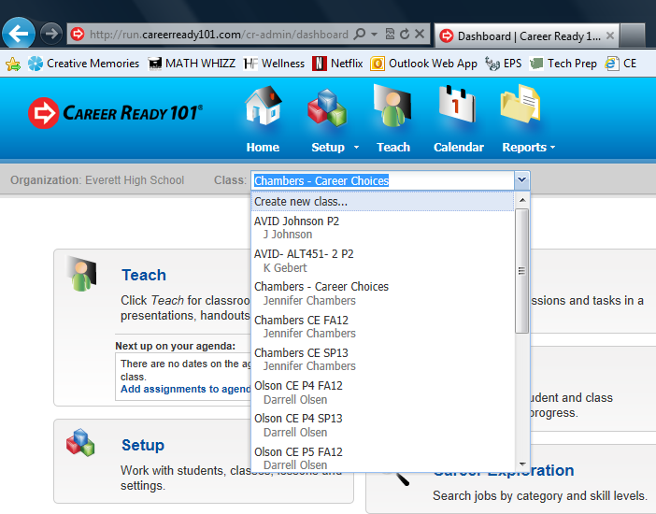
Select the Correct Course

Slide 4
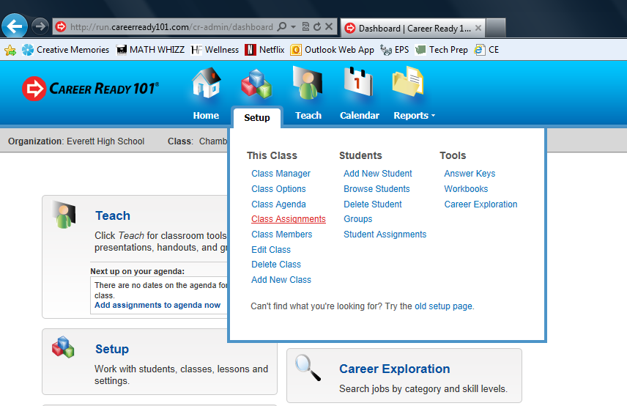
Select: Setup, Class Assignments

Slide 5
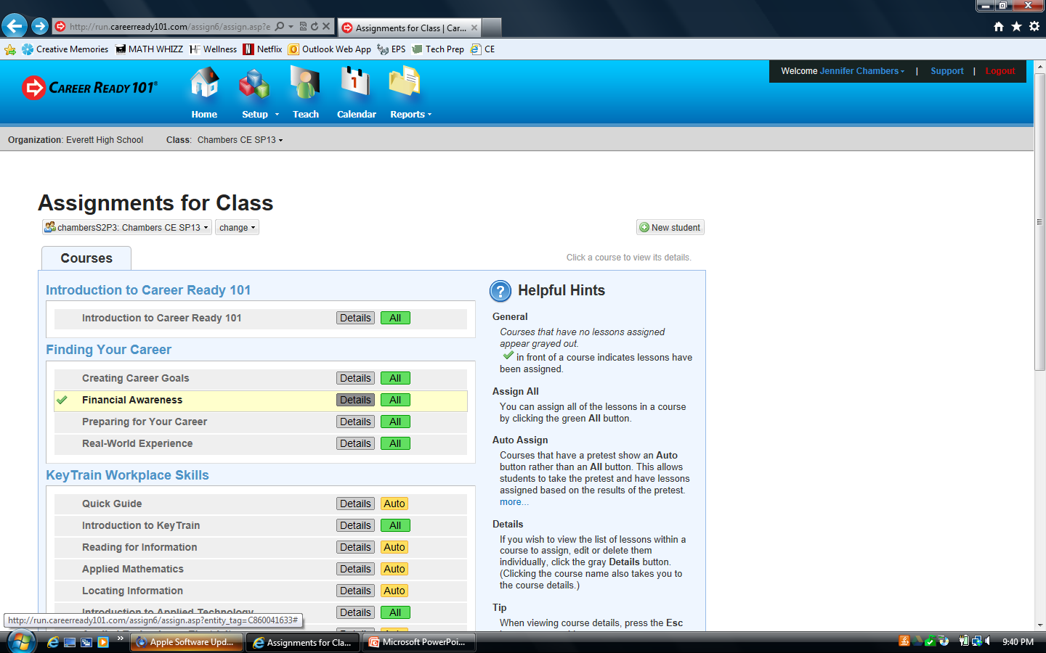
Select the Details button for the lesson you wish to assign

Slide 6
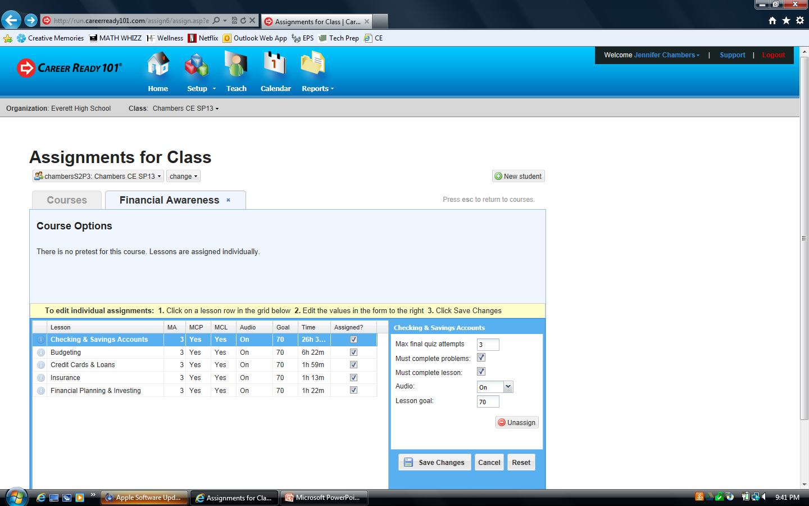
Selecting Specific Lessons
Click on the Assigned box of the lesson you want to assign

Slide 7
Edit Settings for a Specific Lesson
In the box to the right, edit the settings for each lesson. You can change/set:
  The number of attempts per quiz
  Require students to complete problems within the lesson in order to take the quiz
  Require students to complete a lesson in order to take the quiz
  Allow Audio or not
  A Minimum Lesson Goal Score (based on this score, it will show as passed or failed for the lessons’ quiz attempt)
Select Save Changes

Slide 8

Repeat Steps for Additional Classes
To return to the Units of Study List, press the Esc key

Slide 9
Career Ready 101
Directions on How to View/Print Students’ Results

Slide 10
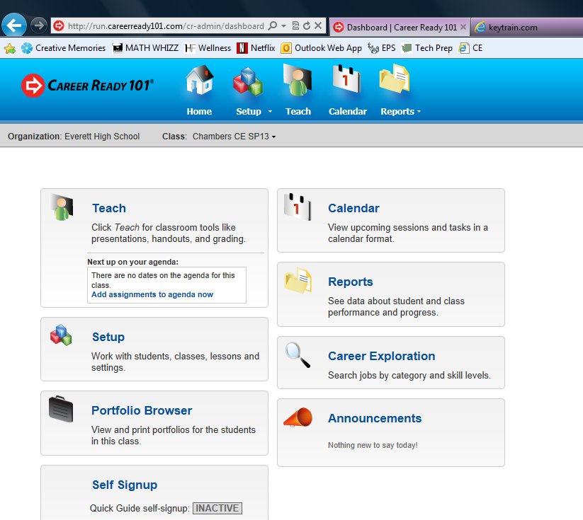
Select: Reports from the Home Page

Slide 11
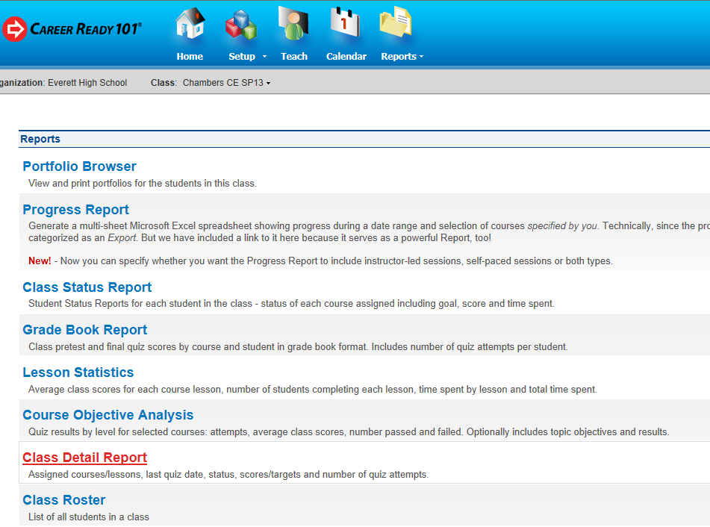
Select: Class Detail Report

Slide 12
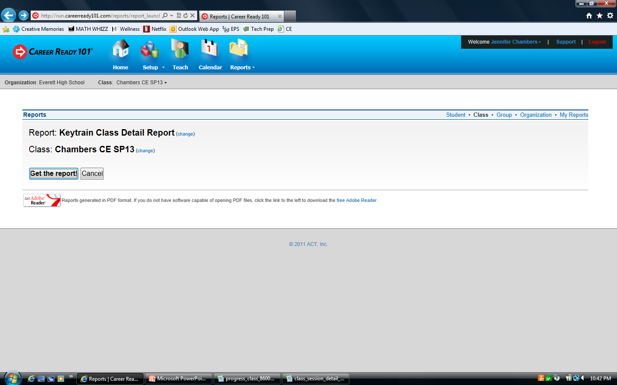
Select: Get the Report

Slide 13
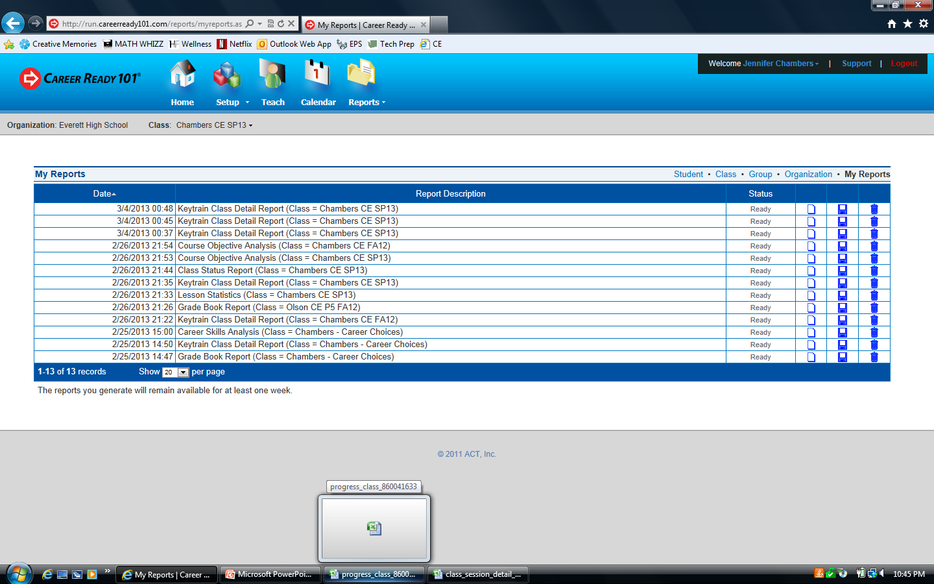
Open the Report
To open the Report, wait for status to read Ready and then select the icon that looks like a piece of paper (you can save a copy)

Slide 14
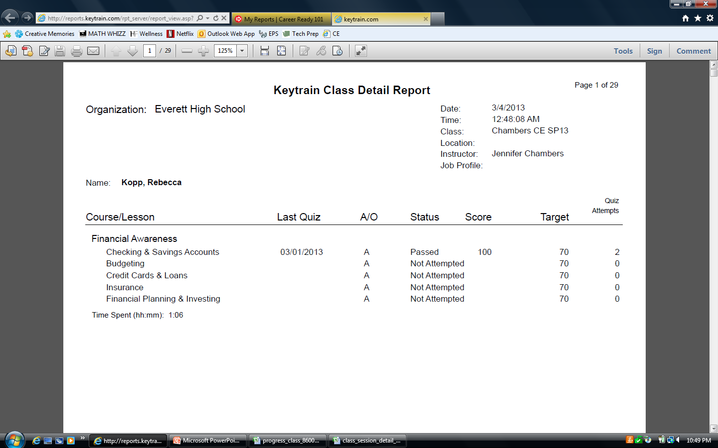
How to Read & Use
* Each student has their own sheet, so if you wish, you can print and give to students

Slide 15
Career Ready 101
Directions on How to View/Print Quick Glimpse

Slide 16
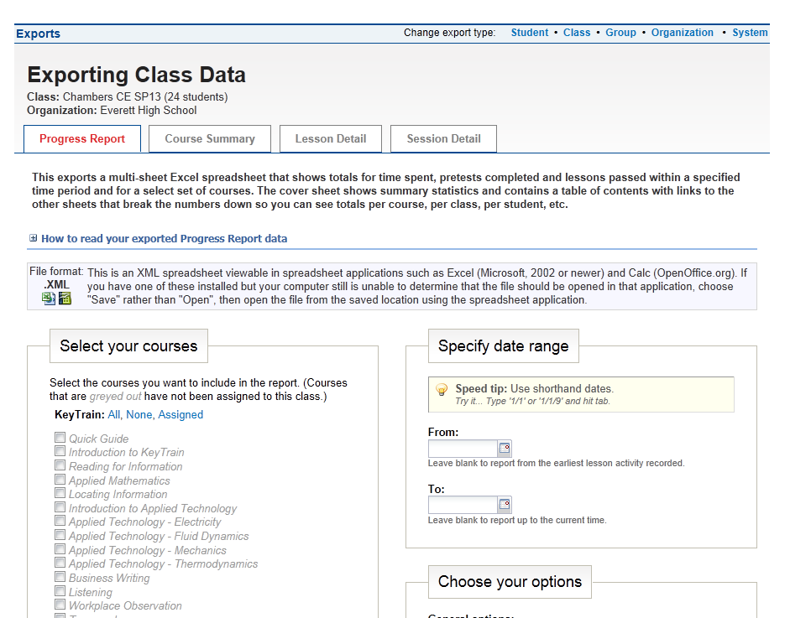
Open Excel and then minimize (important to do this first)
From the Home Screen, select Reports Icon at the TOP of the screen
From the dropdown menu, select Class from the Exports list…

Slide 17
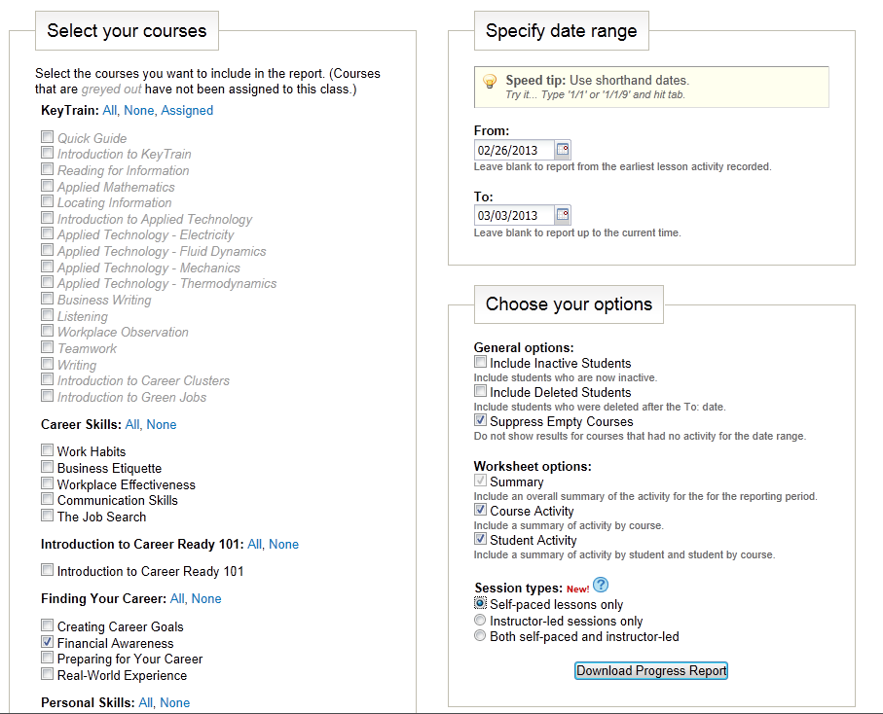
Select Options You Want Included

Slide 18
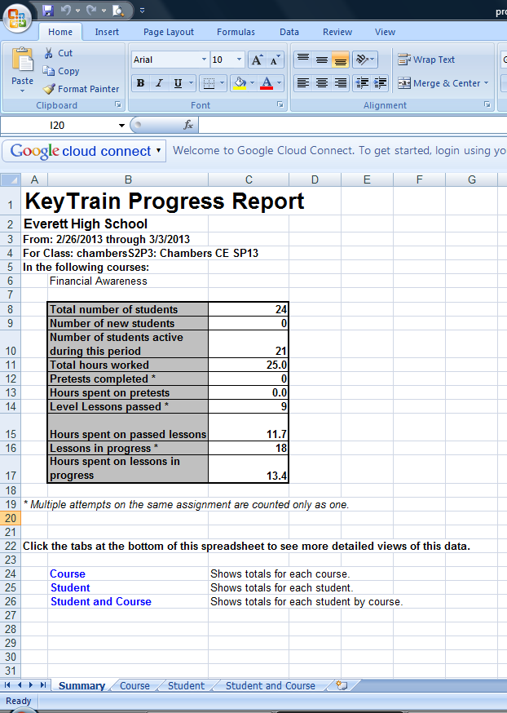
Viewing in Excel

Slide 19
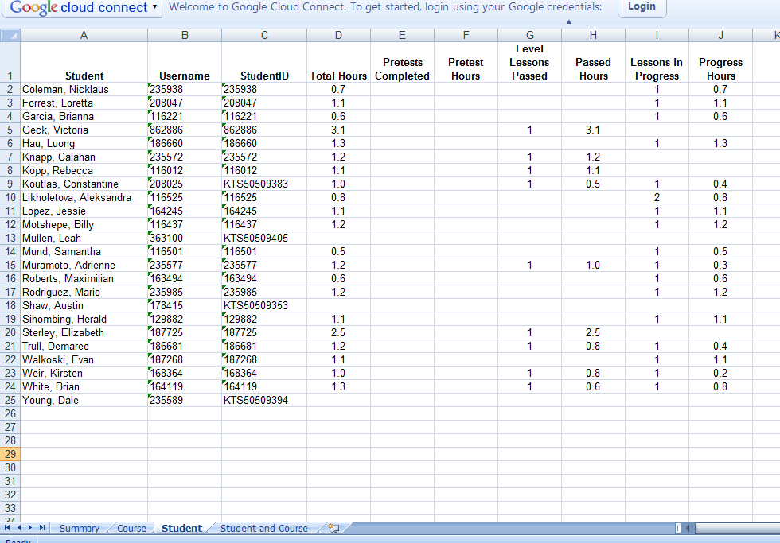
Viewing Quick Glimpse - Student

